Slide 1
Multipliers
CPSC 321 Computer Architecture
Andreas Klappenecker

Slide 2
Multiplication
More complicated than addition
  accomplished via shifting and addition
More time and more area
Let's look at 3 versions based on gradeschool algorithm
0010 (multiplicand)
__x_1011 (multiplier)
0010 x 1
00100 x 1
001000 x 0
0010000 x 1
00010110
Shift, and add if multiplier bit equals 1

Slide 3
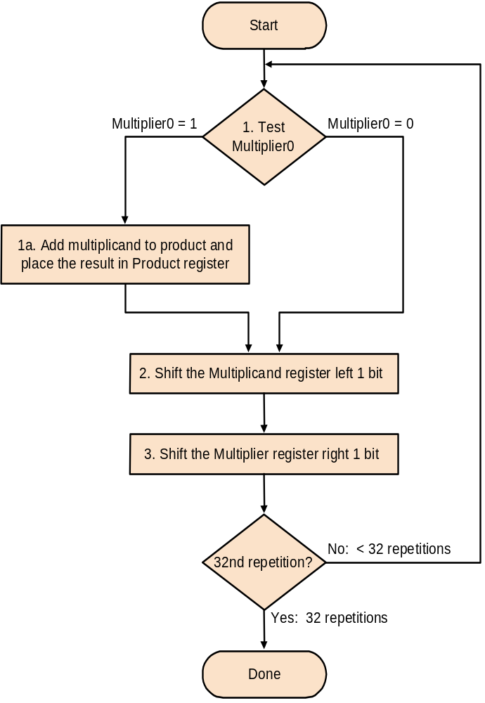
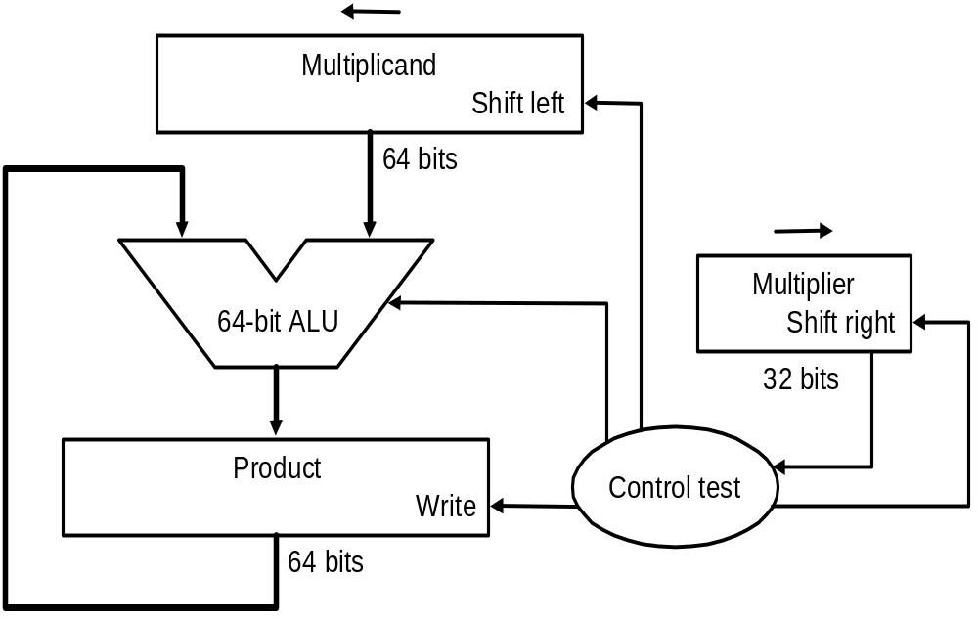
Multiplication: Implementation

Slide 4
Multiplication
If each step took a clock cycle, this algorithm would use almost 100 clock cycles to multiply two 32-bit numbers.
Requires 64-bit wide adder
Multiplicand register 64-bit wide

Slide 5
Variations on a Theme
Product register has to be 64-bit
  Can we take advantage of that fact?
  Yes! Add multiplicand to 32 MSBs
  product = product >> 1
  Repeat last steps
New algorithm needs fewer resources

Slide 6
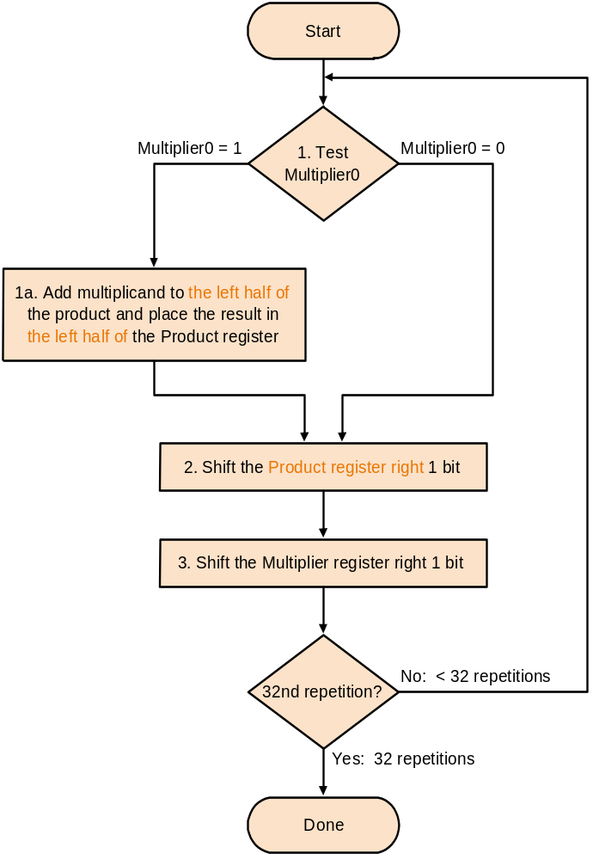
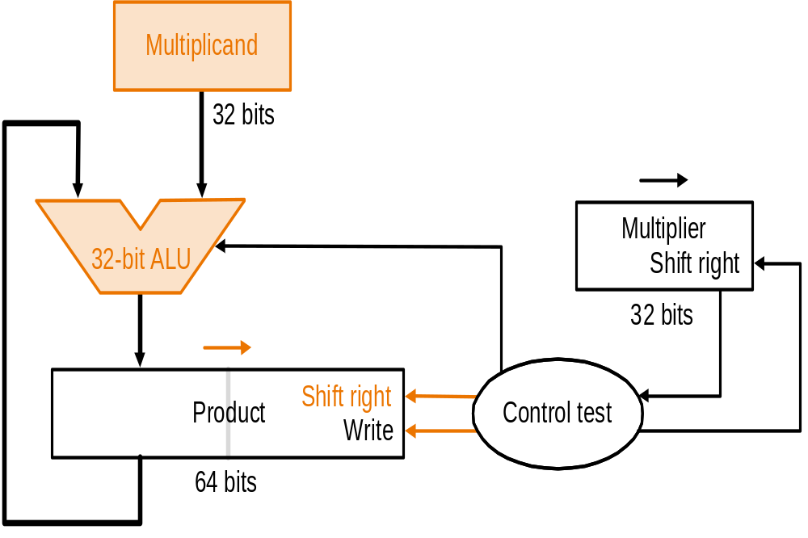
Second Version

Slide 7
Critique
Registers needed for
  multiplicand
  multiplier
  product
Use lower 32 bits of product register:
  place multiplier in lower 32 bits
  add multiplicand to higher 32 bits
  product = product >> 1
  repeat

Slide 8
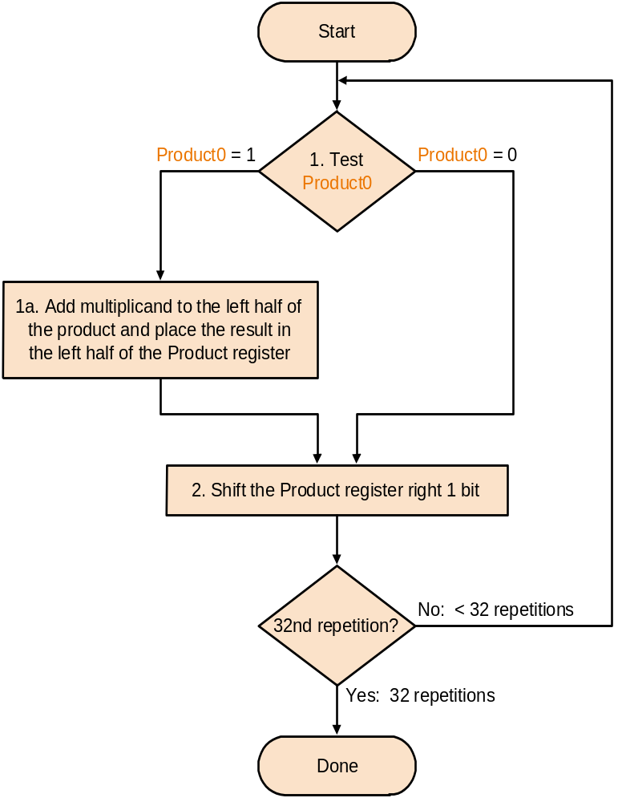
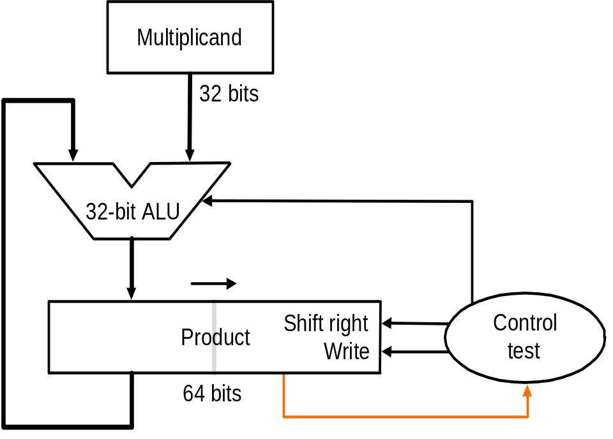
Final Version

Slide 9
Multiplying Signed Numbers
  If sign(a)!=sign(b) then s = true
  a = abs(a)
  b = abs(b)
  p = a*b /* multiply as before */
  negate p if s = true
  Algorithm is straightforward but awkward

Slide 10
Some observations
01110₂ = 14 = 8+4+2 = 16 – 2
Runs of 1s (current bit, bit to the right):
  10 beginning of run
  11 middle of a run
  01 end of a run of 1s
  00 middle of a run of 0s

Slide 11
Booth’s multiplication
Booth’s algorithm looks at 2 bits of the multiplier and modifies the previous algorithm as follows:
  00 middle of 0s run, no arithmetic op
  01 end of a string of 1s, add multiplicand to left part of product
  11 middle of 1s run, no arithmetic op
  10 start of run of 1s, subtract multiplicand from left part of product

Slide 12
Example: 0010 x 0110
Iteration | Mcand | Step | Product
0 | 0010 | Initial values | 0000 0110 0
1 | 0010 0010 | 00: no op arith>> 1 | 0000 0110 0 0000 0011 0
2 | 0010 0010 | 10: prod-=Mcand arith>> 1 | 1110 0011 0 1111 0001 1
3 | 0010 0010 | 11: no op arith>> 1 | 1111 0001 1 1111 1000 1
4 | 0010 0010 | 01: prod+=Mcand arith>> 1 | 0001 1000 1 0000 1100 0

Slide 13
Why Booth’s algorithm works
a=(a₃₁a₃₀a₂₉a₂₈ … a₃a₂a₁a₀.a₋₁)₂
Express a*b as
  (a₋₁ – a₀) x b x 2⁰
  (a₀ – a₁) x b x 2¹
  (a₁ – a₂) x b x 2²
  …
  (a₂₉ – a₃₀) x b x 2³⁰
  +(a₃₀ – a₃₁) x b x 2³¹
  b x (- a₃₁ 2³¹ + a₃₀ 2³⁰ +…+ a₁ 2¹+ a₀ 2⁰)
01: 1-0 = add
10: 0-1 = sub
11: 1-1 = nop
00: 0-0 = nop

Slide 14
Conclusions
The Booth multiplication works for two’s complement numbers
In MIPS assembly language
  mult or multu
  Result contained in registers Hi and Lo
  mflo = move the lower 32 bits
  mfhi = move the higher 32 bits

